Slide 1
Digital Portfolio
STUDENT NAME: Nathiya.V
REGISTER NO AND NMID: 222411462 717E490F78528F2BB094502921
DEPARTMENT: BSC.COMPUTER SCEINCE
COLLEGE: COLLEGE/ UNIVERSITY OF MADRAS& MANGALAM COLLEGE OF ARTS AND SCEINCE,

Slide 2
PROJECT TITLE
Interactive digital portfolio using front end development
Interactive digital portfolio using front end de

Slide 3


AGENDA
Problem Statement
Project Overview
End Users
Tools and Technologies
Portfolio design and Layout
Features and Functionality
Results and Screenshots
Conclusion
Github Link
3/21/2024 Annual Review

Slide 4

PROBLEM STATEMENT
Recruiters often overlook talented candidates due to poor online presence. A personal portfolio
website solves this by offering a centralized, visually appealing profile.

Slide 5

PROJECT OVERVIEW
In an age where first impressions are often digital, a personal portfolio website bridges the gap between
a resume and a real-world introduction. This project is designed to serve as a digital identity — a
dynamic space where visitors can learn about who am , what I’ve accomplished, and how to reach out.
● A warm About Me section
● Clear Education and Skills listings
● Verified Certificates
● A working Contact Form

Slide 6

WHO ARE THE END USERS?
Students (academic projects,resumes).
Job seekers(to share with recuriters). .

Slide 7

TOOLS AND TECHNIQUES
Html
Css
Java script…Interactivity(mobile navigation menu toggle)
Visual Studio Code

Slide 8
POTFOLIO DESIGN AND LAYOUT
Home
About Me
Skills
Projects
Achievements
Contact
Responsive navigation with hamburger menu
Responsive layout(mobile,desktop, view)
8

Slide 9
FEATURES AND FUNCTIONALITY
Responsive navigation bar with hamburger menu for mobile view
Skills section displayed using simple list
Certificates section displayed in grid format
Contact details with email, phone number
Footer copyright

Slide 10
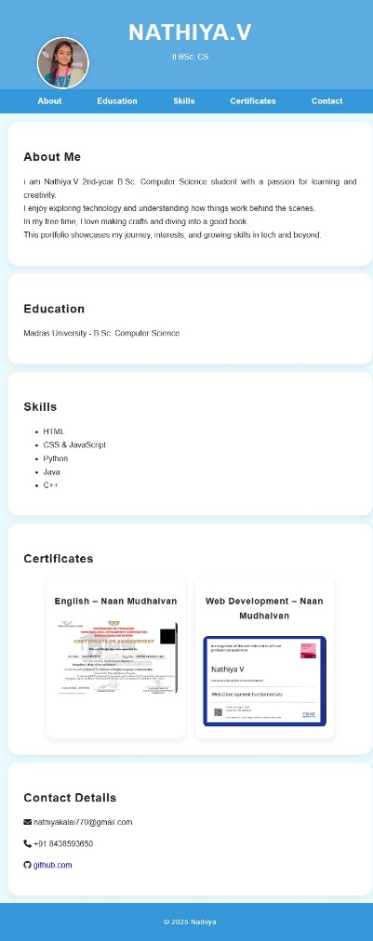
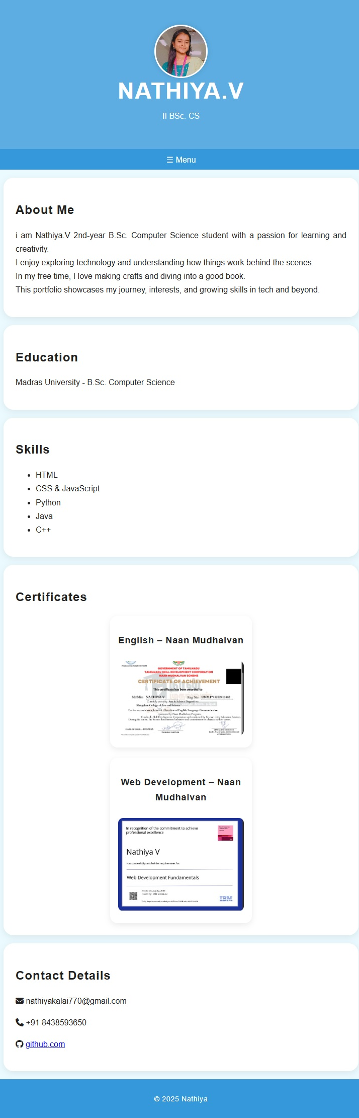

RESULTS AND SCREENSHOTS
Desktop view
Mobile view
3/21/2024 Annual Review
10

Slide 11
CONCLUSION
The portfolio demonstrates how a structure layout can showcase both academic and personal interests. It provides easy navigation, responsive viewing, and a clean user experience.
https://nathiyakalai770-boop.github.io/nm-prj/
11

